Slide 1





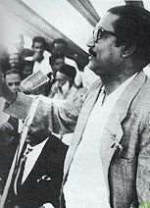

SIX POINT MOVEMENT

Slide 2
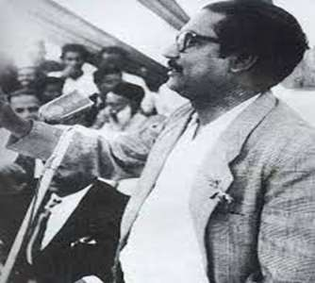
INTRODUCTION
Six-point Program a charter of demands enunciated by the AWAMI LEAGUE for removing disparity between the two wings of Pakistan and to put an end to the internal colonial rule of West Pakistan in East Bengal.
Six-Point Program is called as – “The charter of freedom to the Bengali Nation”
Sheikh Mujibur Rahman, the Awami League President unfolded a Six Point Program on 13 February, 1966.
The movement's main agenda was to realize the six demands put forward by a coalition
of Bengali nationalist political parties in 1966.

Slide 3
BACKGROUND
The main source of the inspiration of the Six-Point Program lies on the original concept of Pakistan that it would consist of 'independent Muslim States'.
The Awami League Council meeting at Dhaka in February, 1966 proved to be a famous platform where Six Point Formula for autonomy of East Pakistan was adopted.
It was presented publically in March, 1966 in Lahore before an all political parties meeting.
The main exponents of Six Point Formula were Tajuddin Ahmed, Sheikh Mujibur Rahman, and Ruhul Quddus.

Slide 4
Six-point Movement(Two Economy Theories)
Year | Spending on West Pakistan (in millions of Pakistani rupees) | Spending on East Pakistan (in millions of Pakistani rupees) | Amount spent on East as percentage of West
1950–55 | 11,290 | 5,240 | 46.4
1955–60 | 16,550 | 5,240 | 31.7
1960–65 | 33,550 | 14,040 | 41.8
1965–70 | 51,950 | 21,410 | 41.2
Total | 113,340 | 45,930 | 40.5
Source: Reports of the Advisory Panels for the Fourth Five Year Plan
1970–75, Vol. I, published by the planning commission of Pakistan.

Slide 5
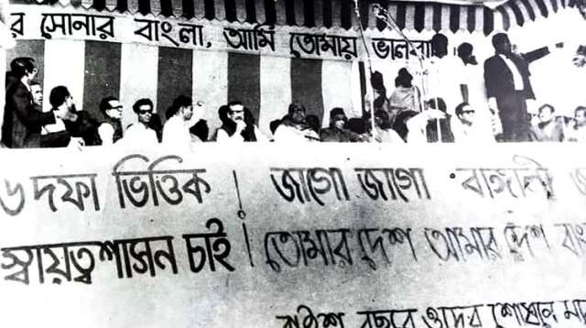
Preparation and dissemination of the draft of 6-point movement
🠶 TheSix Point programme of the Awami League was launched in 1966.
🠶 The Six Point Formula for regional autonomy was set out in a written statement, which was to have been placed before the Lahore Conference.
🠶 It was published under the title
"Six Point Formula-Our Right to Live“ on March 23, 1966.
🠶 Rehman Sobhan,Nurul Islam,Khairul.
Kabir, and other prominent intellectuals drafted the six-point demand.

Slide 6

Leading person of 6-point movement
Banghabandhu Sheikh Mujibur Rahman.

Slide 7
THE SIX POINTS
point 1
The Constitution should provide for a Federation of Pakistan in its true sense based on the Lahore Resolution, and the parliamentary form of government with supremacy of a Legislature directly elected on the basis of universal adult franchise.

Slide 8



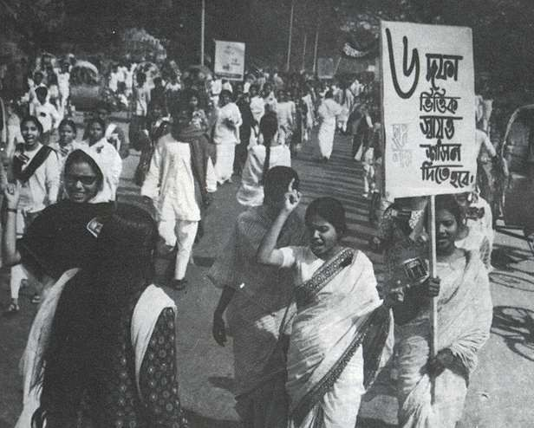

POINT 2
The federal government should deal with only two subjects: Defence and Foreign Affairs, and all other residual subjects should be vested in the federating states.

Slide 9
POINT 3
Two separate, but freely convertible currencies for two wings should be introduced; or if this is not feasible, there should be one currency for the whole country, but effective constitutional provisions should be introduced to stop the flight of capital from East to West Pakistan. Furthermore, a separate Banking Reserve should be established and separate fiscal and monetary policy be adopted for East Pakistan.

Slide 10
POINT 4
The power of taxation and revenue collection should be vested in the federating units and the federal centre would have no such power. The federation would be entitled to a share in the state taxes to meet its expenditures.

Slide 11
POINT 5
There should be two separate accounts for the foreign exchange earnings of the two wings; the foreign exchange requirements of the federal government should be met by the two wings equally or in a ratio to be fixed; indigenous products should move free of duty between the two wings, and the constitution should empower the units to establish trade links with foreign countries.

Slide 12
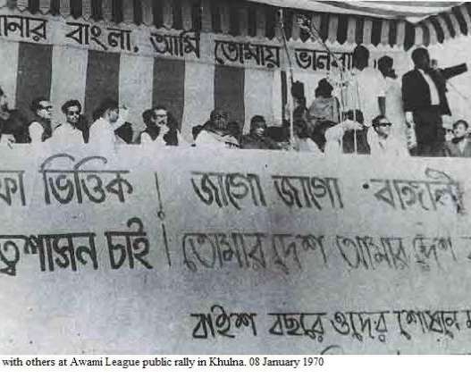
POINT 6
East Pakistan should have a separate military or paramilitary force, and Navy headquarters should be in East Pakistan.

Slide 13
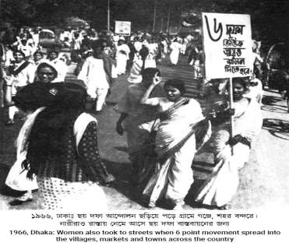
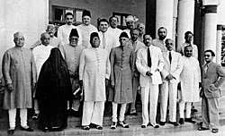
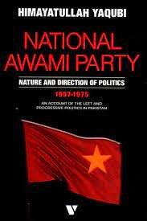
Political parties and 6 point movement:
The Council Muslim League called the programme ‘nothing but the programme for the separation of East Pakistan
The National
(NAP) ignored
Awami Party
the Six Point
June 7 in 1966 the Awami League called a countrywide hartal.
The Nizam-i-Islam & Jammat-I
–Islam rejected the programme
Programme on the ground
and blamed Mujib for his unilateral and dictatorial move.

Slide 14
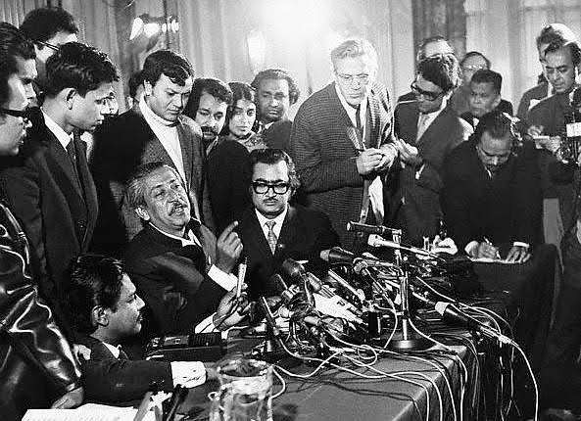
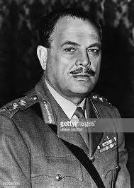
Reaction of West Pakistan on 6-Point Movement
President Ayub remarked that it is the conspiracy for establishing a Hindudominated United Bengal
The press in West Pakistan described it as cessasionist agenda.

Slide 15
Historical significance of 6-point movement
The six-point demand is a milestone event in the history of Bangladesh.
As a result, the economists, intelligentsia, and the politicians of East Pakistan started to raise questions about this discrimination, giving rise to the historic six-point movement. The

Slide 16
SIGNIFICANCE
Thunderous expression against oppression.
Final expression of Bengali nationalism
Demand for autonomy
Expression to become self-reliant.
Total opposition and final movement against Government of Pakistan.
Awareness of the value of democracy.
Increased the popularity of Awami League
Impact upon the 1970 Election.
Seed to the eventual independence of Bangladesh.
Road To liberation
Eleven Point Movement 1968-69
Agartala Conspiracy
Mass Uprising, 1969
Election of 1970

